Slide 1
BUAD5072
Machine Learning I

Slide 2
Agenda
What Will Be Doing and Why it is Important
A Look at the Syllabus
My Expectations, Deliverables, and Grading
Basic Concepts
Getting Started with Swirl

Slide 3
Contact Info
Dr. Pamela Schlosser
Office: Miller Hall, Room 3010
Zoom Office Hours: T 4:00pm-5:00pm; MW 11:00am-12:00pm
Phone:757-221-7415
Email: pamela.schlosser@mason.wm.edu

Slide 4
Course Description
CRN:11917 -- Machine Learning 1 -- This is the first of two courses designed to equip students with the kinds of analytical skills used in the era of Big Data to reveal the hidden patterns in, and relationships among, data elements being created by internal transaction systems, social media and the Internet of Things. A family of analytical methods, collectively referred to as "Machine Learning" methods, has grown out of the Artificial Intelligence community and has become commonplace in many of the world’s leading analytics competitors. This first course focuses on the basics of machine learning, regression techniques, classification techniques and how to avoid over-fitting predictive models. The R language is used extensively in this course.

Slide 5
Course Goals
Broadly: To approach business problems analytically
Think carefully and systematically about whether and how data can improve business performance
Specifically: To develop competency in machine learning methods through hands-on experience (using R)
Know the basics of the most common machine learning concepts, processes, and model-building techniques. In doing so, we will seek to understand the underlying algorithms for each technique

Slide 6
This Course
This course lives at the intersection of computer science and applied math.
Machine Learning is particularly well-suited to the world of Big Data, where Volume and Variety are extreme.
The number of potential predictor variables is often very large.
Patterns and relationships are often difficult to perceive due to high levels of variability in small-sample observational data –with Big Data, we approach n= All, providing the statistical power necessary to reveal these subtle effects.
Important patterns and associations in data are often unintuitive.

Slide 7

Our Book and Software Used
Book: Link to text: https://www.statlearning.com/ Software
R >4.0
Link to datasets: https://www.statlearning.com/resources-first-edition
The instructor will always use a Windows computer

Slide 8
Why R?
R is a very sophisticated statistical software package
Easily installed, state-of-the-art, and it is free and open source
Enter R statements one-at-a-time through the command line, or write scripts using the R language
Steeper learning curve, but once over the hurdle, becomes relatively easy

Slide 9
Overview of Class Schedule
Part 1: Learning R
Part 2: Descriptive and Predictive Learning
Getting Started
Creating and Manipulating Data in R
Basic Data Management in R
Advanced Data Management in R
Data Visualization
Linear Regression
Logistic Regression
Discriminant Analysis

Slide 10
Covid-19 Acknowledgement
This is a dynamic syllabus, meaning it may undergo change. This class will follow the rules and guidelines outlined by the university regarding best practices surrounding Covid-19. There is a chance that recommended protocols for delivering class material will change based on new information. In the event this happens, I will update our syllabus on Blackboard and inform you in class or via email. It is the student’s responsibility for reviewing the syllabus for changes each week on Blackboard.

Slide 11
Attendance and Punctuality
Attendance is required and I will take attendance regularly. I expect you to be present and ready to begin work at the scheduled class start-time. Punctuality is very important as late arrivals or late entrants can be highly disruptive to the flow of the material. As such, absences and tardiness are treated equally. Please be considerate of your fellow students and make every effort to arrive on time and avoid leaving class once it has started. Unless an approved exception has occurred, students must keep the class time open for continual synchronous delivery in person all semester.

Slide 12
Information on Accommodations and Codes
ADA Accommodation
W&M Honor Code
William & Mary accommodates students with disabilities in accordance with federal laws and university policy. Any student who feels they may need an accommodation based on the impact of a learning, psychiatric, physical, or chronic health diagnosis should contact Student Accessibility Services staff at 757-221-2512 or at sas@wm.edu to determine if accommodations are warranted and to obtain an official letter of accommodation. For more information, please see www.wm.edu/sas. Students must receive clearance from the Student Accessibility Office (SAS) before faculty are obligated to accommodate extra time on exams, etc.
Accommodations must be double checked by the student and confirmed with the professor prior to any exam for correctness.
The College of William & Mary has had an honor code since at least 1779. Academic integrity is at the heart of the College, and we all are responsible for upholding the ideals of honor and integrity. The student-led honor system is responsible for resolving any suspected violations of the Honor Code, and I will report all suspected instances of academic dishonesty to the honor system. The Student Handbook (www.wm.edu/studenthandbook) includes your responsibilities as a student and the full Code. Your full participation and observance of the Honor Code is expected. To read the Honor Code, see www.wm.edu/honor. All academic work in this course is to be your own.

Slide 13
Information on Recording and Copyright
Recording Class Sessions
Notice of Copyright
Students are strictly prohibited from recording class sessions and other interactions with the instructor using any type of technology. Recordings and synchronous class sessions provided by the instructor are protected by both copyright and the Family Education Rights and Privacy Act (FERPA) and may not be shared or redistributed to anyone at any time now or in the future. To do so is both a violation of law and of W&M’s Honor Code.
All course materials, including the syllabus, lectures, presentations, recordings, quizzes, assessments, tests, exams, outlines, assignments, electronic files, and similar materials, for this course are protected by copyright and are the sole property of the course instructor. You may use these materials for your personal, non-commercial educational use. You may not, nor may you knowingly allow others, to reproduce or distribute any course materials publicly without the express written consent of the instructor. This includes providing materials to commercial course material suppliers such as CourseHero and other similar services. To do so is both a copyright violation and a violation of W&M’s Honor Code.

Slide 14
Diversity and Inclusion
William and Mary welcomes students from around the country and around the world, and their unique perspectives enrich our learning community. It is our collective responsibility to create and foster an environment that is inclusive and respectful for all. To do this we must demonstrate:
Respect and responsibility for self and others
A spirit of generosity
A life dedicated to inquisitive learning and development
An acknowledgement that an individual’s own words, actions, and relationships show a commitment to these values
I would like to create a learning environment that supports a diversity of thoughts, perspectives and experiences, and honors your identity. To help accomplish this, please notify me:
If you have a name and/or set of pronouns that differ from those that appear in your official W&M records.
If you feel like your performance in the class is being impacted by your experiences outside of class.
If something was said or done in the classroom, by either myself or another student, that causes discomfort or offense.

Slide 15
Face Mask Policy
Please do your part in keeping our university community safe. Per university policy, wearing of face mask is required in all public or communal spaces including classrooms until further notice. This face mask must fully cover your mouth and nose. Although students and faculty normally interact in close proximity during class, especially just before and just after class at or near the podium, that will not be possible this semester. To better accommodate our need to be in close proximity to review assignments or assist in solving technology issues, office hours will be held via Zoom to allow screen sharing.

Slide 16
Recommended Equipment
Because you will be remote for at least some portion of this course due to social distancing requirements, I strongly advise you to obtain a secondary monitor to work effectively in the course. This is because one monitor will need to be used to receive my shared screen which will contain multiple windows and there is simply not enough space on your laptops to then split my shared screen with your own version of software we are using to work along with me. The plan, therefore, is to have one monitor to view my shared screen and the other monitor for your own software. External monitors (try to get a 24 to 27 inch one) are inexpensive to purchase, but you may also use a high-definition television for this second monitor. This second monitor will come in handy for any other hybrid or remote courses you take. You should also have a quality headset (preferable noise cancelling) with a built-in microphone to use while on Zoom both in and outside of class.

Slide 17
Dress Code Policy
ML1 follows the dress code outlined by the MSBA program:
Business Casual: The expected dress is long khaki pants and a button-down shirt, or dress of comparable formality.
Casual Friday: formality of dress is relaxed on Friday, although attire should never be distracting, sloppy, or too revealing. For example, jeans and a polo shirt are acceptable: athletic shorts, pajamas, and sweatpants are not.
Guest Speakers: dress is business causal on any day on which we are hosting a guest speaker.

Slide 18
Deliverables and Grading: Case Study Policy
There are 4 category B case studies: a group assignment. These case studies will be completed asynchronously within the window allowed and stated on Blackboard. These case studies must be completed and submitted through Blackboard by the due date in the system unless an approved accommodation is made in advance. Absolutely no case studies will be accepted via email unless directly requested by the instructor.
Exceptions to Case Study policy may include a documented University activity or a documented emergency situation beyond the student's control. This documentation must be received through the dean of student’s office or SAS.
The dates are set on the last page of the syllabus for these assignments. If a documented exception is made for one person in a group, and that group member was unable to contribute, the remaining group members should submit their group assignment on time and the person with the approved accommodation will require a separate individual assignment.

Slide 19
Deliverables and Grading: Attendance, Punctuality, and Participation Policy
Attendance will be taken regularly and punctuality is expected. At various class times, participation exercises will be given to ensure attentiveness. If recommended swirl exercises are completed during class time, they will count towards your participation grade. Other activities completed during class time will also count towards participation and attendance is required to receive completion credits.
Swirl exercises will be open note/open book, and are designed as checks to test for active learning of the material. These exercises are to be taken in R using the swirl package. You may take these swirl exercises as many times as you want in R to practice outside of class.

Slide 20
Deliverables and Grading: Examinations Policy
Exams: There will be one midterm and one cumulative final exam delivered during the scheduled block time. These exams will cover all assigned textbook readings, R scripts, and in-class material. All work must be shown on programming problems in order to receive credit. In other words, if you do not show your work, you may not receive any credit, even if your answer is correct.
The midterm exam is currently scheduled in Brinkley on Friday, October 22nd from 9:30AM-11:00AM.
The final exam is scheduled for December 16th time pending.

Slide 21
Grading Policies and Procedures
Grade Components
Case Study | 32%
Attendance and Participation | 8%
Midterm | 30%
Final Exam | 30%
Grading Point System
Grade | >= | < |  | Grade | >= | <
A | 95% | --- |  | C+ | 77% | 80%
A- | 90% | 95% |  | C | 73% | 77%
B+ | 87% | 90% |  | C- | 70% | 73%
B | 83% | 87% |  | F | --- | 70%
B- | 80% | 83%

Slide 22
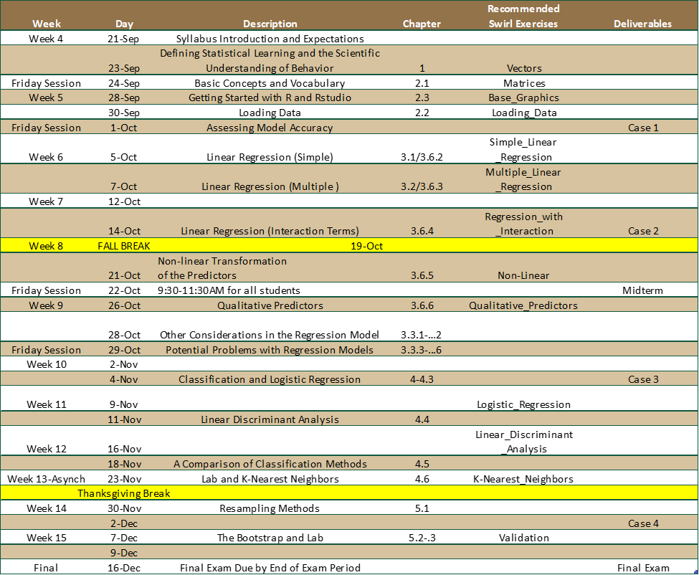
Timeline of Events

Slide 23
My Expectations About What You Already Know
Knowledge about the computer
Saving Files
Zipping Files
Locating Files
Using Blackboard
Probability and Statistics
The basic elements of probability and statistics from your introductory Statistics course, with emphasis on descriptive statistics (e.g.: mean, variance, standard deviation), probability
Basic Knowledge of Programming
Variables
Functions
Formulas
Conditional Statements
Loops
Information from Bootcamp.
We’ll review these principles as we go along, as necessary.

Slide 24
Terms: Data Science vs. Business Analytics
These terms are evolving, and there is presently little agreement on their precise meanings and the relationships among them.
Data Science is the broader term –it is often used to refer to high-level principles associated with extracting useful and actionable knowledge from data.
Business Analytics is then Data Science applied to business.
Machine Learning, Statistical Learning, Data Mining and Business Intelligence are particular approaches to Business Analytics (others are Simulation and Optimization).

Slide 25
Business Analytics is Much More than Information Technology
Business Analytics Lives Here
Digital Literacy:
Data Management
Analysis Tools for Data Analysis
Programming
Systems Design and Development
Quantitative Literacy
Data Analysis
Probability
Descriptive and Inferential Statistics
Optimization
Experimental Design
Interdisciplinary Business and Industry Knowledge
Marketing
Finance
Economics
Operations
Supply Chain
Human Resource Management
Leadership Competencies
Creative Problem Solving
Building Relationships
Project Management and Business Process Design
Communicating with Impact
Teamwork and Negotiation Skills
Digital Literacy
Quantitative Literacy
Interdisciplinary Business and Industry Knowledge
Leadership Competencies

Slide 26
Business Analytics is the use of:
data,
information technology,
statistical analysis,
quantitative methods, and
mathematical or computer-based models
to help managers gain improved insight about their business operations and make better, fact-based decisions.
Machine Learning/Statistical Learning/Data Mining
These terms differ slightly in scope and emphasis, but there is a very large overlap and we will use them synonymously in this class

Slide 27
What is Machine Learning?
Machine Learning is the analysis of (often large) observational data to find unsuspected relationships and to summarize the data in novel ways that are understandable , actionable and useful to the business strategically, tactically and/or operationally.
Another perspective:
Traditional: (databases, computer programs)
Model driven (simulation, optimization)
Data driven (machine learning)

Slide 28
What is Big Data in Machine Learning?
Data: numbers or textual data that are collected through some type of measurement process
Information: result of analyzing data; that is, extracting meaning from data to support evaluation and decision making
Big Data refers to massive amounts of business data (volume) from a wide variety of sources (variety), much of which is available in real time (velocity). Big data includes data that needs to be clean and accurate (veracity) and have value.
Variability has also been of concern because the data is always changing.
Notes:
https://hdsr.mitpress.mit.edu/pub/l7a2t45s/release/1

Slide 29
Descriptive, Predictive, and Prescriptive Analytics
Descriptive analytics: the use of data to understand past and current business performance and make informed decisions
Predictive analytics: predict the future by examining historical data, detecting patterns or relationships in these data, and then extrapolating these relationships forward in time.
Prescriptive analytics: identify the best alternatives to minimize or maximize some objective

Slide 30
Descriptive, Predictive, and Prescriptive Analytics
We will cover:
Predictive Learning: Intended to predict what will happen based on historical data and trends.
Descriptive analytics: What happened? the use of data to understand past and current business performance and make informed decisions.
Predictive analytics: What will happen? predict the future by examining historical data, detecting patterns or relationships in these data, and then extrapolating these relationships forward in time.
Prescriptive analytics: What should I do? identify the best alternatives to minimize or maximize some objective.
Descriptive Learning: Intended to inform, describe, track, alert, generate hypotheses, but not to predict, explain, or prescribe.

Slide 31
To do:
Get acquainted with the Syllabus on Blackboard.
Find and download the book (or order it).
https://www.statlearning.com/
Go onto the authors website and download the data files for future use.
https://www.statlearning.com/resources-first-edition
Complete your first swirl exercise for participation credits: Vectors

Slide 32
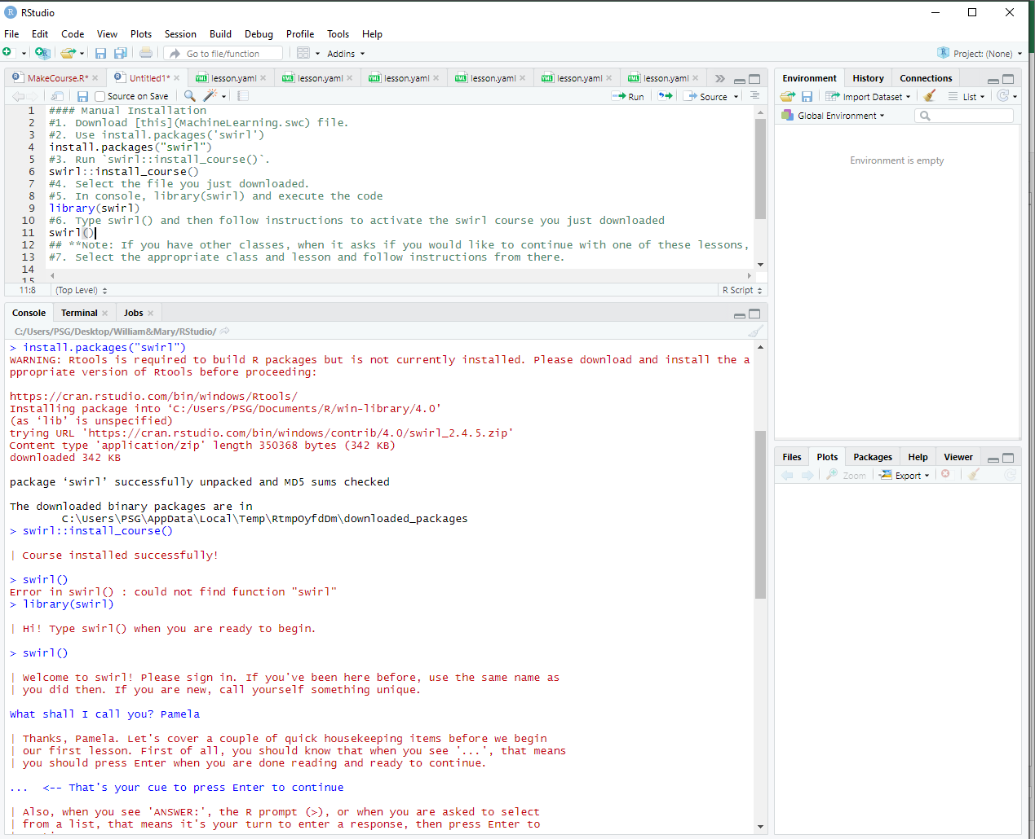
Adding Our Swirl Class to R
#### Manual Installation From an R Script File
#1. Download [this](MachineLearning.swc) file.
#2. Use install.packages('swirl')
install.packages(‘swirl’)
#3. Run `swirl::install_course()`.
swirl::install_course()
#4. Select the file you just downloaded.
#5. In console, library(swirl) and execute the code
library(swirl)
#6. Type swirl() and then follow instructions to activate the swirl course you just downloaded
swirl()
## **Note: If you have other classes, when it asks if you would like to continue with one of these lessons, you may need to say No. Let me start something new.
#7. Select the appropriate class and lesson and follow instructions from there.

Slide 33
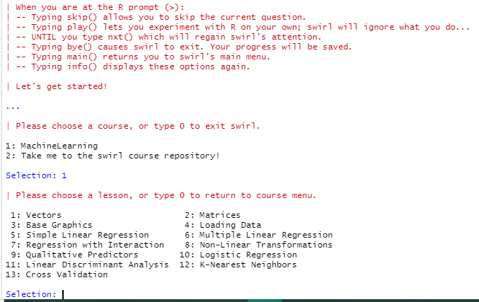
Adding Our Swirl Class to R
After you go through the housekeeping items, you should select the Machine Learning class.
Our first participation exercise is Option 1: Vectors. This exercise has a lot of intro information about R.

